Slide 1
Harp 150: Game Project
By: Joshua Cheuk and Daniel Wong
Notes:
Go through slides and run through the code
Talk abt problems after the explanations are done such as bug fixing

Slide 2
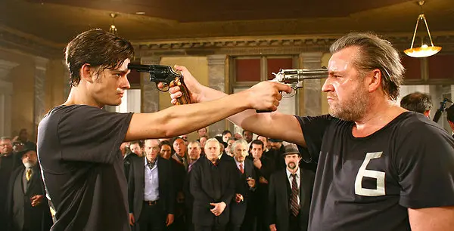
Theme of Game:
Our game is inspired by the very famous “russian roulette,” a game popularized by movies and TV shows where two people hold a revolver to their opponent’s head. Each revolver has one bullet randomly placed in the chamber, and the person who survives, wins. It is typically used in movies to create a suspenseful scene between two characters at odds with each other, and they are settling it through this game.

Slide 3
Planning Process:
We wanted to incorporate the random module into our gameplay
Thus, we planned to code two different classes with modules that affected the player and the computer.
Afterwards, we would put these classes together into one while loop to tie the gameplay together.

Slide 4
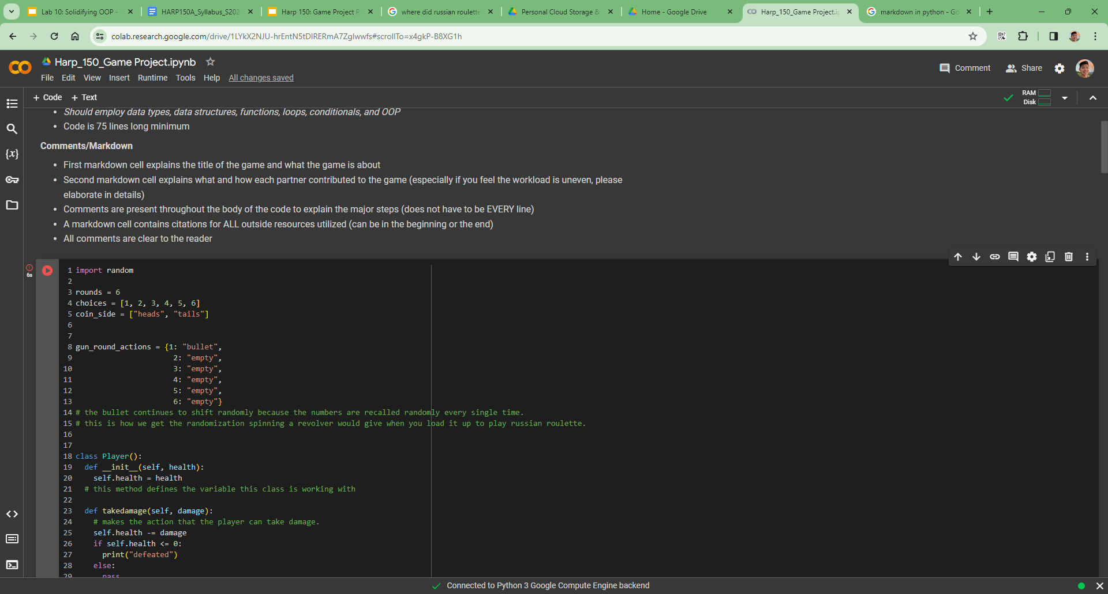
Establishing the basic mechanics
Mechanics such as bullets remaining in the chamber, random choice for the bullet being shot, and a coin flip to decide the first player.
Use random to decide whether it has a bullet or not: it cycles through 1-6 and if it lands on 1, there is a bullet.

Slide 5
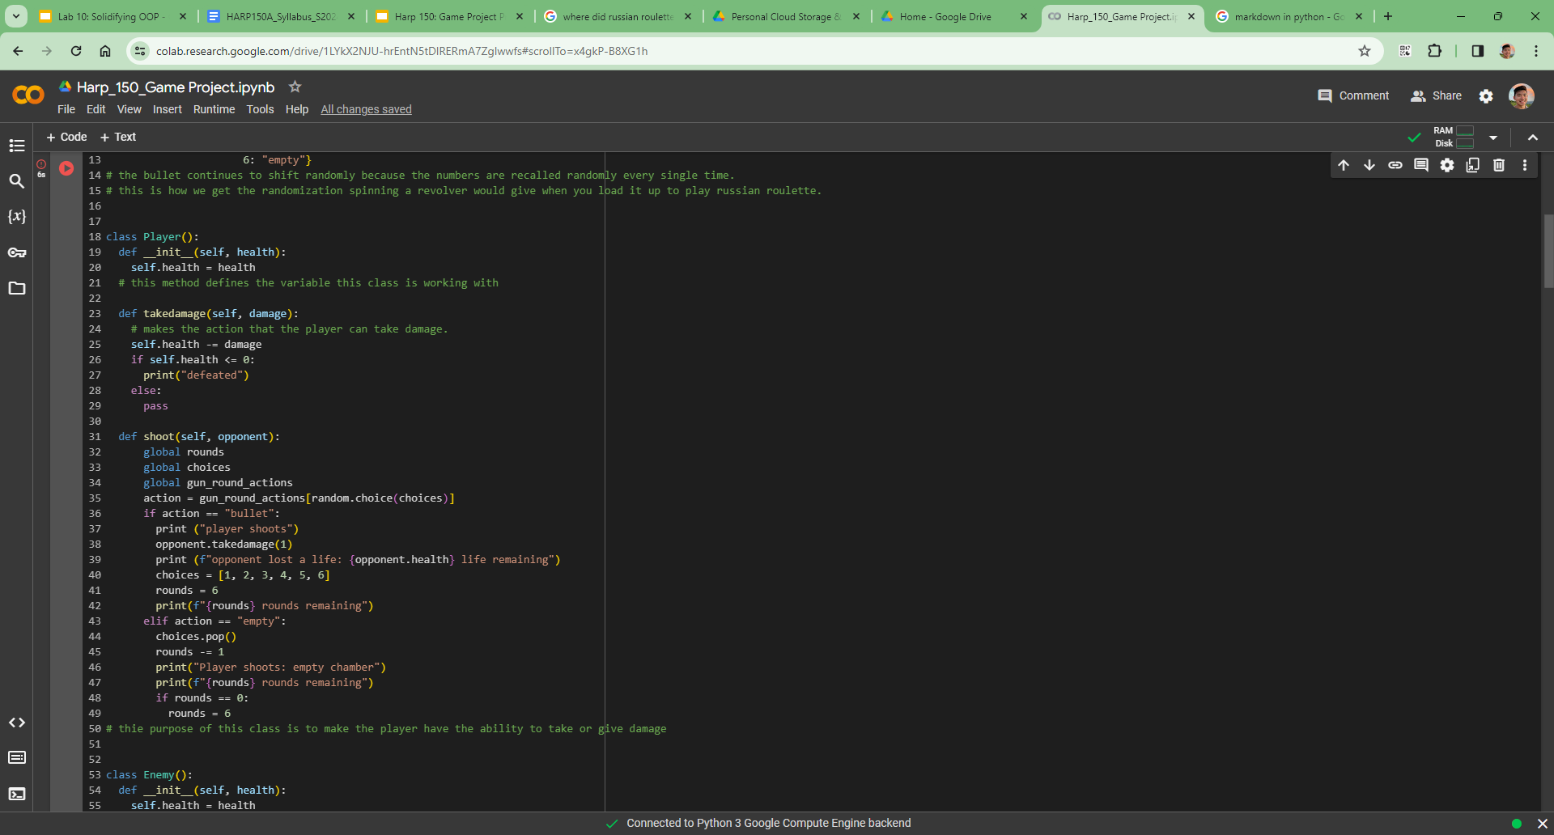
Creating classes and Methods
Creating classes for the player that defines the players health and a method to take damage
Create a method to shoot the gun by randomly selecting choices 1-6 that corresponds to the original dictionary

Slide 6
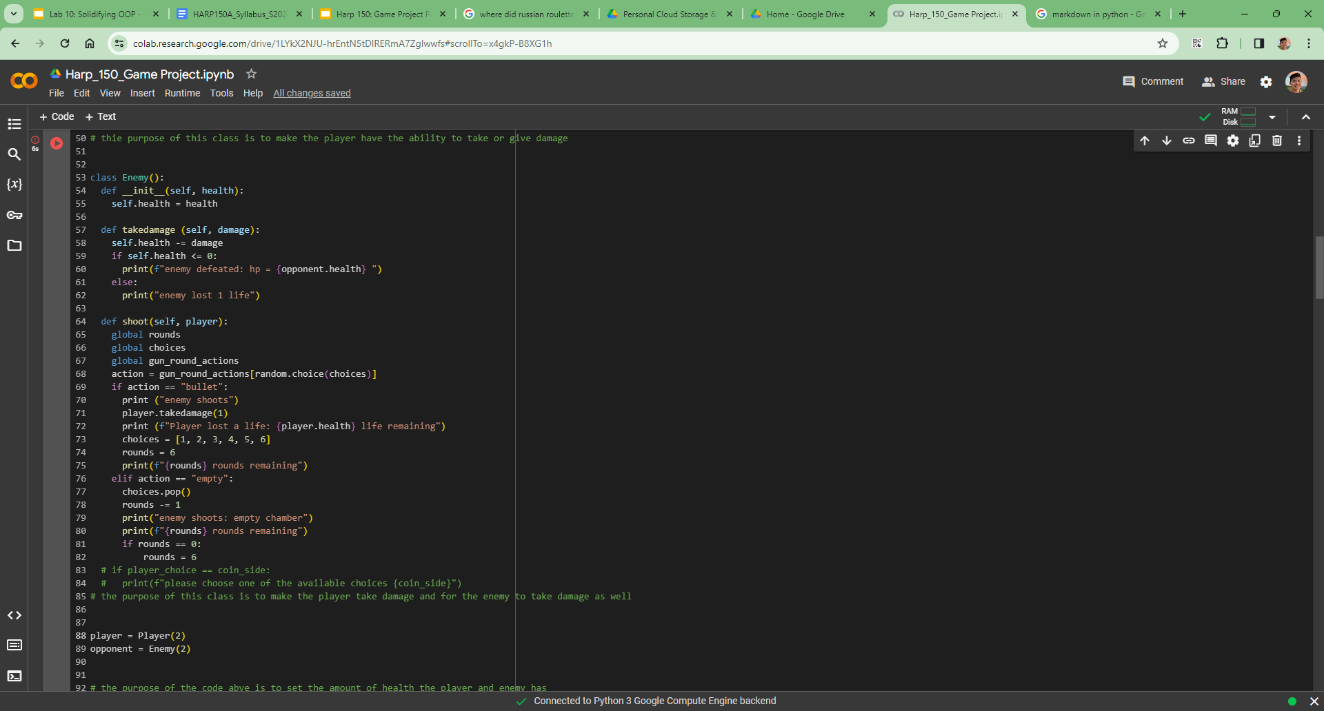
Creating classes and Methods continued
Creating classes for the Opponent that defines its health and a method to take damage almost exactly the same as for the player

Slide 7
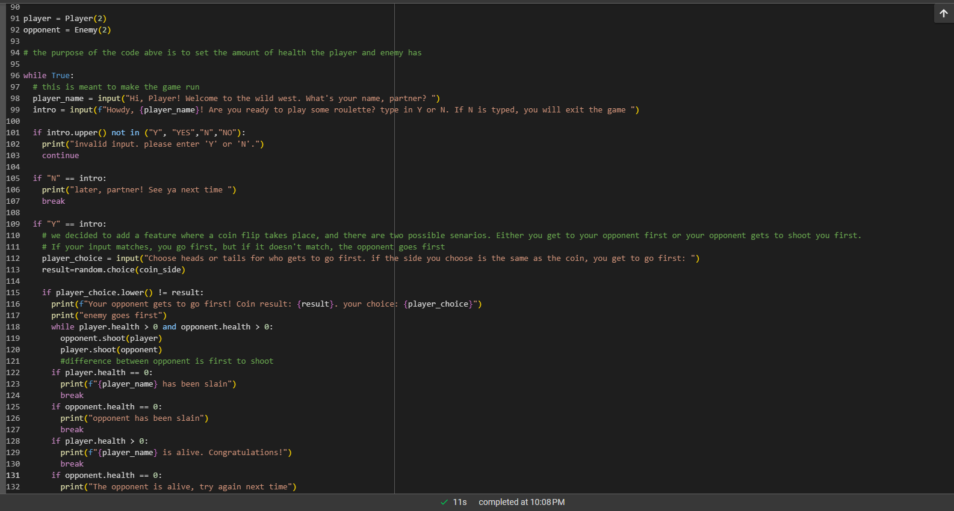
Running the game:
This runs the game in its entirety
Uses concepts like if statements, while loops, and booleans
It incorporates user input in the to make the game interactive and personal and to determine which scenario plays first (the player going first or the computer)

Slide 8
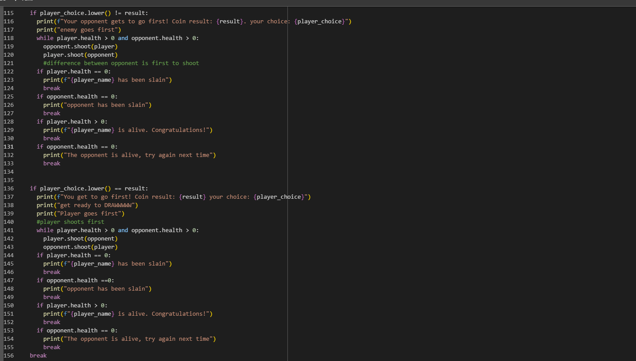
Running the Game Continued
This section of the codeis if the user clicks “Y” in our code.
One scenarios where the player’s choice measures the result of the coin flip
Another scenario where the player’s choice is different than the result of the coin flip
Used concepts such as if statements, loops, booleans, and built-in methods.

Slide 9
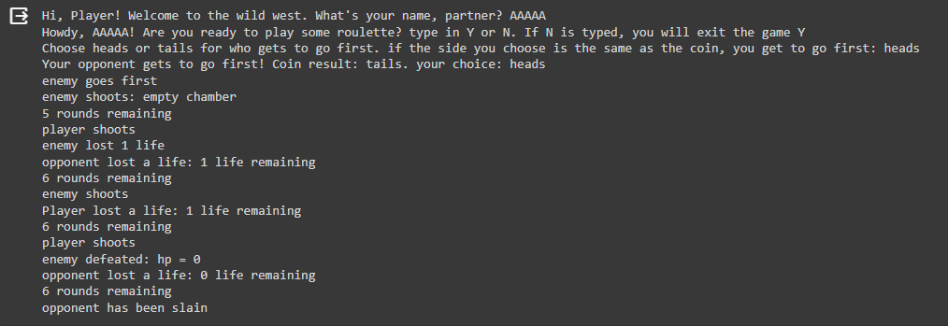
OUTPUT

Slide 10
Bugs and Issues we Overcame
Issue: We also had to think of a way to randomize the bullet spot in the revolver and go to the “next” chamber.
In order to do this we made a list of numbers 1-6 and randomly choose from that list that corresponded to the dictionary. In order to simulate a empty chamber, we removed the last option from the list.
Bug: Bullet rounds wouldn’t be restored and reset after a bullet was fired
Needed the “global” method to access lists and dictionaries within a function
Reinserted the original list rather than modify it
Bug/Issue: Debugging our revolver- after every turn where the chamber was empty, the next turn the bullet would fire. This goes against the the intended function of the game where each turn had a ⅙ chance for the revolver to fire the bullet.
We fixed this issue by adding if statements to the shooting method in the player and enemy that diminished the health of the player and enemy respectively when the revolver landed on the bullet

Slide 11
Thank You For Watching!

Slide 12
Presentation length/structure
Video is between 8-15 minutes long (-1pt if over)
Group members spend an equal amount of time speaking
Presentation has a clear introduction, middle, and conclusion
__/2
Presentation Content
Key ideas are clearly explained and it is easy to follow the code
Explains planning process of the game & why this game was chosen
Discusses how the game was built and what kind of debugging was necessary to get it working
__/2
Presentation Style
Video shows presenters’ faces
Speaker has a clear voice
Speaker does not artificially pause to create too much emptiness in the presentation
Speaker has a low word-to-UM ratio
__/1

